Slide 1

Assignment Topic : “Student Journey and Relationship Process with Focus on Decision Drivers of Indian Students when Choosing a German University to Pursue their Master’s Degree”
Applied Project - 1
Guided By :
Prof. Dr. Dirk Stein
Project Group: 1
Ashish Ghosh (586466)
Canny Sen (586465)
Chetan Dalwadi (586459)

Slide 2
Table of Content
Introduction
Theoretical Foundation
Research Design
Research Results
Projection of Results
Conclusion

Slide 3

Introduction
The cost is the main component and expensive schooling has an unfavorable effect on selecting an institute for higher education study.
Germany is responsible for financing almost most of the higher education institutes.
Since, Higher education sectors all over the world are seriously affected by the COVID 19 pandemic. Most of the university's campuses are closed due to pandemics.
Citation:
Eicher, Jean-Claude. 1998. “The Costs and Financing of Higher Education in Europe.” European Journal of Education 33 (1): 31–39.
Dhaliwal, Manjinder Singh, Amit Mittal, Arun Aggarwal, and Pawan Kumar Chand. 2019. “Determining the Factors Affecting the Selection of Private Universities and Colleges in Indian Context: A Structural Equation Modeling Approach.” Journal of Advanced Research in Dynamical and Control Systems 11 (8 Special Issue): 2579–90

Slide 4

Assignment Topic
Problem Statement
False career selection has major consequences as it does not only affect an individual's or organization’s growth but also impacts the economy as a whole. Cost is a critical factor for international students, as the cost of education or living expenses is often a colossal burden for middle-class families.

Slide 5

Assignment Topic
Research question
How have economic factors affected students influencing to choose German University?

Slide 6

Assignment Topic
Expected Outcome
As a result of analyzing the data, we will gain a better understanding of the economic factors that are critical for Indian students in choosing a German university.

Slide 7
Research Design
Assignment Topic
Research Question
Qualitative Research
Refine
Research Methodology
Quantitative Research
Survey
Tools
Excel/
Python
Collect
Data Collection
Summarize
Structure & Analyse
Data
Analysis
Insights
Conclusion
Interpret
Source: Author’s own representation

Slide 8
Milestone
2 Dec. 2022
Milestone 1
Background
Problem Statement
Research Question
Project Plan
10 Dec. 2022
Goal–I
Modification Based on Feedback
20 Dec. 2022
Goal-II
Final Approach of Solution Design
21 Jan. 2022
Goal-III
Cleaning & Processing of data
27 Jan. 2022
Goal-IV
Analysis of data
7 Feb. 2022
Milestone 3
Final Presentation
Live Demo of Analysis
Documentation
15 Jan. 2022
Milestone 2
Collecting relevant data form questioner
Deployment of questioner
Literature Review
Literature Analysis
Source: Author’s own representation

Slide 9
Task Allocation
Sr. No. | Task | Persons Responsible
1 | Background Research | All team members
2 | Research Design | Chetan Dalwadi , Canny Sen
3 | Table of Contents | Canny Sen
4 | Project Planning | Chetan Dalwadi
5 | Literature Analysis | Ashish Ghosh, Chetan Dalwadi
6 | Solution Approach | All team members
7 | Proof of concept Questionnaire Development | Canny Sen, Chetan Dalwadi
8 | Proof of concept Analysing Response | Canny Sen
9 | Scientific work - documentation | All team members
Source: Author’s own representation

Slide 10
Literature Reviews
Source | Topic | Key Findings | Country
Eicher, Jean-Claude. 1998. “The Costs and Financing of Higher Education in Europe.” European Journal of Education 33 (1): 31–39. | The costs and financing of higher education in Europe | Student participation in the financing of their studies is still lower than the optimum seems to justify in many European countries. Tuition fees are increasing in different forms and methods. This trend will probably continue because the financial burden on public powers is generally considered too great and for the reasons of efficiency and equity we have already mentioned. | UK & Germany
Dhaliwal, Manjinder Singh, Amit Mittal, Arun Aggarwal, and Pawan Kumar Chand. 2019. “Determining the Factors Affecting the Selection of Private Universities and Colleges in Indian Context: A Structural Equation Modeling Approach.” Journal of Advanced Research in Dynamical and Control Systems 11 (8 Special Issue): 2579–90. | Determining the factors affecting the selection of private universities and colleges in Indian context: A structural equation modeling approach | The present study examines the various factors that affect the student’s choice regarding the selection of a higher educational institution in India. For this, the data was collected from students who were residing in Chandigarh and Tri-city region.. The findings of the study will help the top management of the educational institute to plan their policies in such a way that will improve the overall quality of the education provided by their institution. Further, it will also help the new institute to select the location for their institution. | India
Abbas, Jawad, Uthman Alturki, Misbah Habib, Ahmed Aldraiweesh, and Waleed Mugahed Al-Rahmi. 2021. “Factors Affecting Students in the Selection of Country for Higher Education: A Comparative Analysis of International Students in Germany and the UK.” Sustainability (Switzerland) 13 (18). https://doi.org/10.3390/su131810065. | Factors affecting students in the selection of country for higher education: A comparative analysis of international students in Germany and the UK | This research intrigues significant information regarding factors affecting students’ decisions in the selection of country for higher education. This study provides valuable insights to the academic policymakers in the host and home countries concerning factors that pull and push students to study abroad. | Europe

Slide 11
Implementation of Results
Firstly, the demographic questions are formed and related results are shown for the assignment.
For a better understanding, we have followed the PEST analysis method.
Our group has targeted economic factors to select a German University for students.

Slide 12
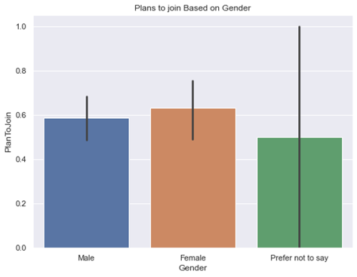
Implementation of Result
Demographic Result
Questions Asked
Please enter your gender.
Are you planning to join a German University within the next 6 months to pursue a master’s degree?
Results
This bar graph depicts the number of students planning to join in the next 6 months based on their gender.
From the graph, we can understand that FOM should concentrate on slightly more interested females than the other two categories.
Fig 1: Planning to join based on Gender

Slide 13
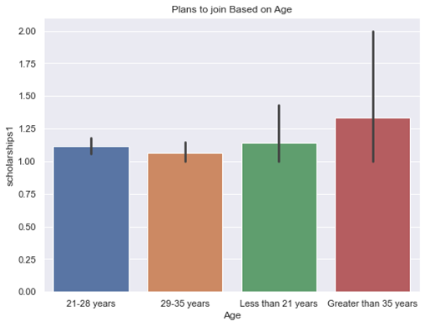
Implementation of Result
Result on Economic Factor
Question Asked
Please enter your age.
The number of scholarships is an important factor that you consider when choosing a course?
Results
This bar graph depicts the number of students planning to join in the next 6 months based on their age groups considering the number of scholarships offered.
Scholarship programs to study at FOM can attract an age group of people who are greater than 35.
Fig 2: Scholarships interest based on age

Slide 14
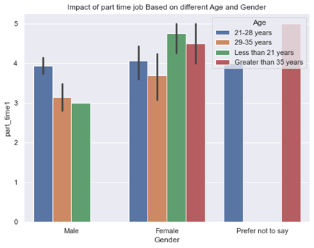
Implementation of Result
Result on Economic Factor
Question Asked
Please enter your gender.
Please enter your age.
The availability of part-time jobs is an important factor when choosing a course.
Results
This graph is a combination of both gender and age group showing how it is being impacted by the availability of part-time jobs.
Providing part-time jobs opportunity at the campus is greatly beneficial in attracting more students.
Fig 3: Availability of part-time jobs

Slide 15
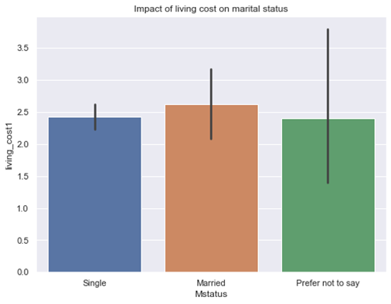
Implementation of Result
Result on Economic Factor
Question Asked
Please mention your marital status
How much are you willing to spend as living costs per month on average?
Results
This graph depicts the impact of living costs as per the marital status.
FOM should concentrate on pitching on married people who are more concerned about living cost factors than singles.
Fig 4: Impact of living cost based on marital status

Slide 16
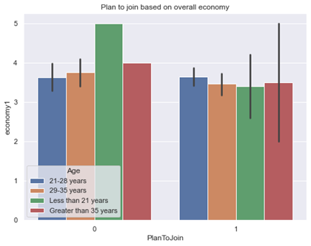
Implementation of Result
Result on Economic Factor
Question Asked
Please enter your age
The country’s overall economy is one of the major factors for selecting the course.
Results
This graph depicts the number of students that plan to join based on the overall economy grouped according to the different age groups.
Provide regular newsletters to the students about the changing trends in the German market and foreign policies.
Fig 5: Joining based on the overall economy

Slide 17
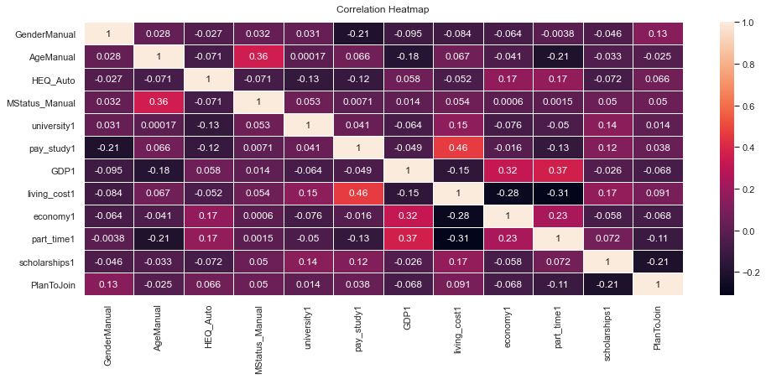
Implementation of Result
Result on Economic Factor
Question Asked
How much are you willing to spend as living costs per month on average?
GDP level per capita is an important metric that I consider when choosing a country to pursue my master's degree.
Results
The heat map depicts living costs and GDP of the country are positively correlated to the students joining a German University.
FOM can consider this factor also for students who are joining to German University.
Fig 6: Heat map

Slide 18
Business Model Recommendation to FOM
Key Partners | Key Activities | Value Propositions |  | Customer Relationships | Customer Segments
Partner universities Education consulting firms Educational events Student association Foreign universities abroad | Content for the course Cultural workshop Placement workshop | Offer quality education according to European standards Flexible study programs tailored to the student's needs Attractive scholarship programs to those aged 35 and above Organize regular networking meets with the local Germans including Provide regular newsletters to the students about the changing trends in the German market and foreign policies Offer workshops on paper publication in various journals the students studying |  | International office at FOM Partner universities in India | 21-28 year old Single Female Students from computer science Background
 | Key Resources
 | Key Resources |  |  | Channels
 | Industrial Contacts of the university Professors from diverse fields The reputation of the university Practical content developed for the courses Strong Alumni Network |  |  | Facebook Internet Instagram Newspaper and magazine ads
Cost Structure Marketing cost Human Resources Customer Support Infrastructure cost |  |  | Revenue Streams Program Fees
Source: Author’s own representation

Slide 19


Tools used for the front end
Google forms
Python

Slide 20

Future Scope
Connect the Indian students who are currently studying in German universities.
Provide career opportunities to Indian students by giving appropriate results.
Integrating the Google form to Python.

Slide 21

Challenges
Finding literature relevant to the topic
Preparing and Deployment of questionnaires
Analyzing of data collected from questionnaire

Slide 22


